Slide 1
Object-Oriented Methodologies

Slide 2
What is Object Oriented Methodology?
It is a new system development approach, encouraging and facilitating re-use of software components.
It employs international standard Unified Modeling Language (UML) from the Object Management Group (OMG).
Using this methodology, a system can be developed on a component basis, which enables the effective re-use of existing components, it facilitates the sharing of its other system components.

Slide 3
What is Object Oriented Methodology?
Object Oriented Methodology asks the analyst to determine what the objects of the system are?,
What responsibilities and relationships an object has to do with the other objects? and
How they behave over time?

Slide 4
Types
There are three types of Object Oriented Methodologies 1. Object Modeling Techniques (OMT) 2. Object Process Methodology (OPM) 3. Rational Unified Process (RUP)

Slide 5
Method & its Strength
Rumbaugh Methodology
Describe the object model or the static structure of the system.
Booch Methodology
Produces detailed design models
Jacobson Methodology
Produces user-driven analysis models

Slide 6
1. Object Modeling Techniques (OMT)
It was one of the first object oriented methodologies and was introduced by Rumbaugh in 1991.
OMT uses three different models that are combined in a way that is analogous to the older structured methodologies.
A method for analysis, design and implementation by an object oriented technique.

Slide 7
Fast and intuitive approach for identifying and modeling all objects making up a system.
Class attributes, methods, inheritance and association can be expressed easily.
Dynamic behavior of objects can be described using the OMT dynamic model.
Detailed specification of state transitions and their descriptions within a system

Slide 8
a. Analysis
The main goal of the analysis is to build models of the world.
The requirements of the users, developers and managers provide the information needed to develop the initial problem statement.

Slide 9
b. OMT Models I. Object Model
It depicts the object classes and their relationships as a class diagram, which represents the static structure of the system.
It observes all the objects as static and does not pay any attention to their dynamic nature.
II. Dynamic Model
It captures the behavior of the system over time and the flow control and events in the Event-Trace Diagrams and State Transition Diagrams.
It portrays the changes occurring in the states of various objects with the events that might occur in the system.

Slide 10
III. Functional Model
It describes the data transformations of the system.
It describes the flow of data and the changes that occur to the data throughout the system.

Slide 11
c. Design
It specifies all of the details needed to describe how the system will be implemented.
In this phase, the details of the system analysis and system design are implemented.
The objects identified in the system design phase are designed.

Slide 12
Example of Object Model

Slide 13
The OMT Dynamic Model
Lets you depict states, transitions, events and actions.
State Transition Diagram is a network of states and events.
States receives 1 or more events at which they make the transition to next state.

Slide 14
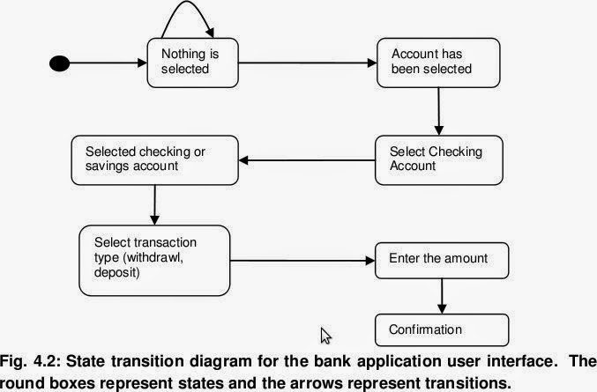
Example for State Transition Diagram

Slide 15
The OMT Functional Model
Data Flow Diagram shows the flow of data between different processes in a business.
OMT DFD provides simple and intuitive approach for describing business processes.
Four Primary Symbols used in DFD are :-
Process → Any function being performed
Dataflow → Shows the direction of data element
Data Store →Location where data is stored
External Entity →source/destination of data element

Slide 18
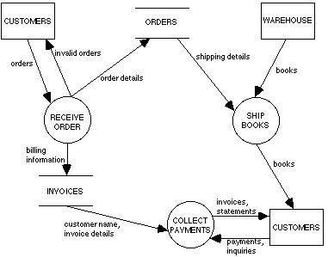
Example for Data Flow Diagram

Slide 19
Case study: Apply Rumbaugh Model for Online ticket reservation System

